Slide 1
CH2PH2:
Chemical Kinetics
Dr. James Hallett
j.e.hallett@reading.ac.uk

Slide 2
Lecture 5
CH2PH2: Chemical Kinetics

Slide 3
experimental reaction kinetics

Slide 4
Studying reaction kinetics
We typically need:
Analytical techniques to measure the reaction
Some method to mix our sample effectively
We could use some other method to initiate the reaction in situ
Need to think about the timescale of the reaction and analytical method

Slide 5
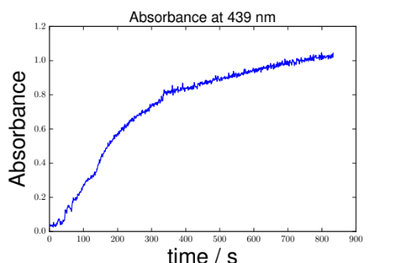
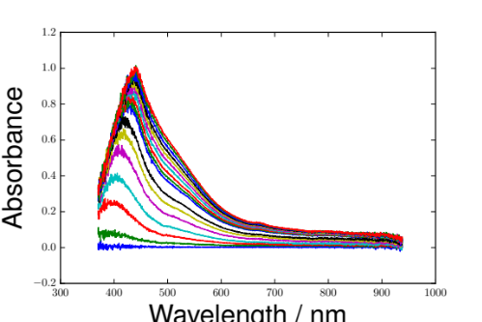
Analytical techniques for kinetics measurements
Time
Fast
Slow
Optical Spectroscopy
Mass Spectroscopy
Titration
NMR
Optimise sample preparation to suit technique of choice
Notes:
Fast and slow methods e.g. absorbance as a function of t, spectra, versus titration, mass spec, NMR

Slide 6
Experimental Approaches
Real-time
Quenching
Continuous flow
Stopped flow

Slide 7
Real-time monitoring
Measure something in the reaction vessel as the reaction takes place
Timescale depends on analytical technique and the speed of mixing
Analytical technique must be fast compared to reaction and non-destructive

Slide 8
Real-time monitoring
Advantages
Disadvantages
Doesn’t necessarily need special equipment
Containers might need to be specially designed

Slide 9
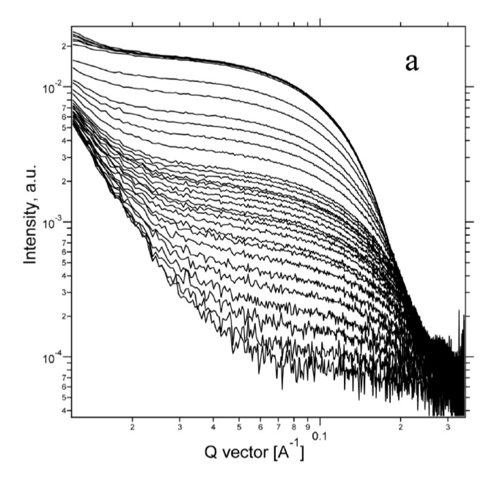
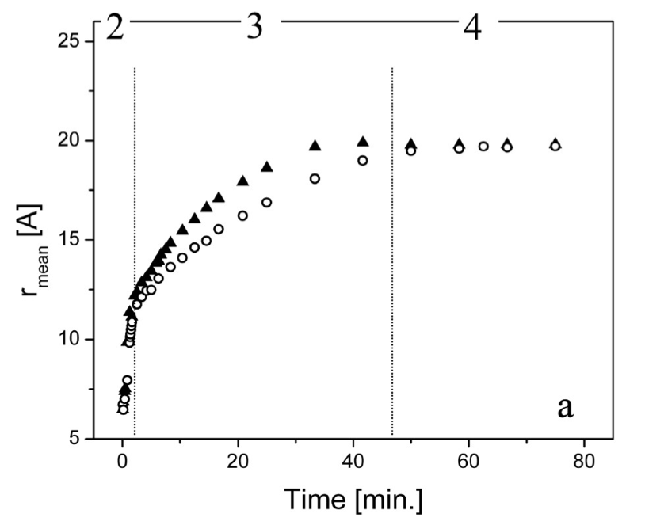
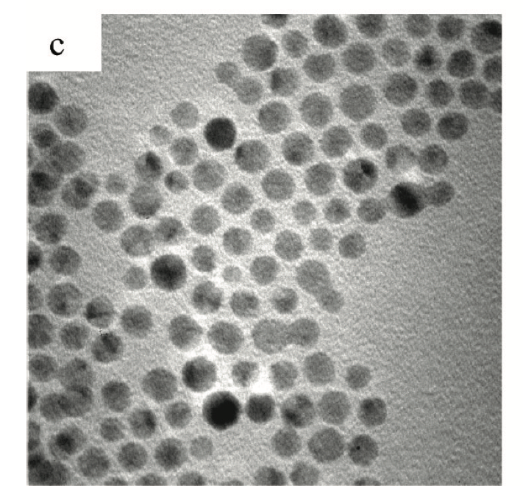
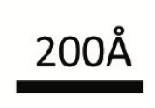
Real-time monitoring:
X-ray scattering of gold nanoparticle synthesis
Koerner, H., MacCuspie, R. I., Park, K., & Vaia, R. A. (2012). In situ UV/Vis, SAXS, and TEM study of single-phase gold nanoparticle growth. Chemistry of Materials, 24(6), 981-995.
Background context

Slide 10
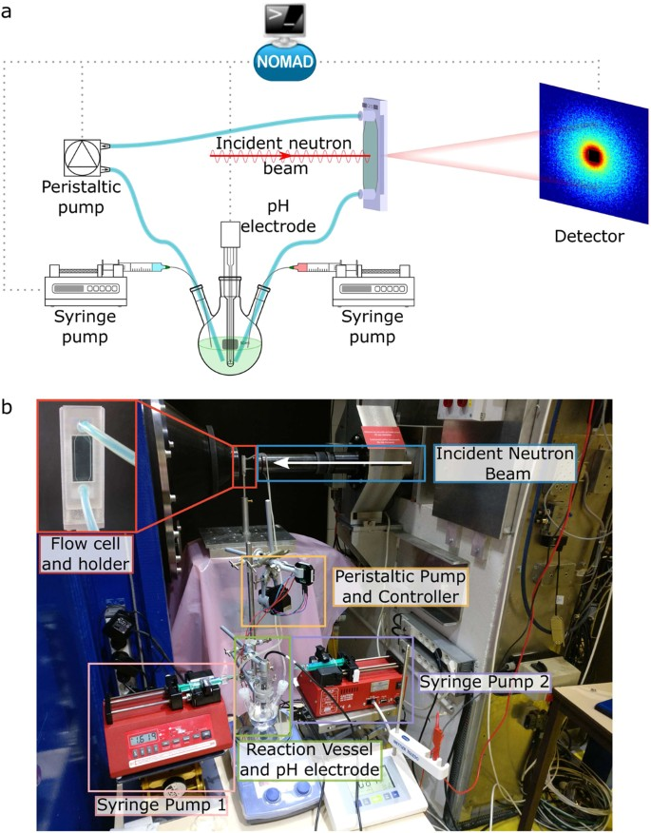
In-situ monitoring – in practice
Hayward, D. W., Chiappisi, L., Prévost, S., Schweins, R., & Gradzielski, M. (2018). A small-angle neutron scattering environment for in-situ observation of chemical processes. Scientific reports, 8(1), 1-11.
Background context

Slide 11
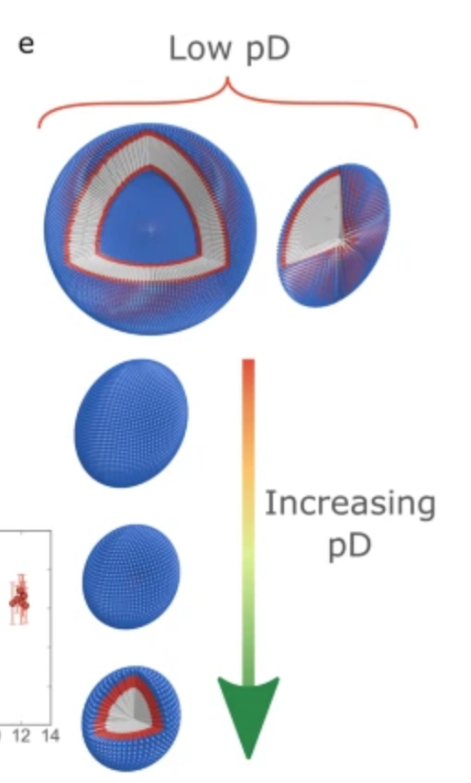
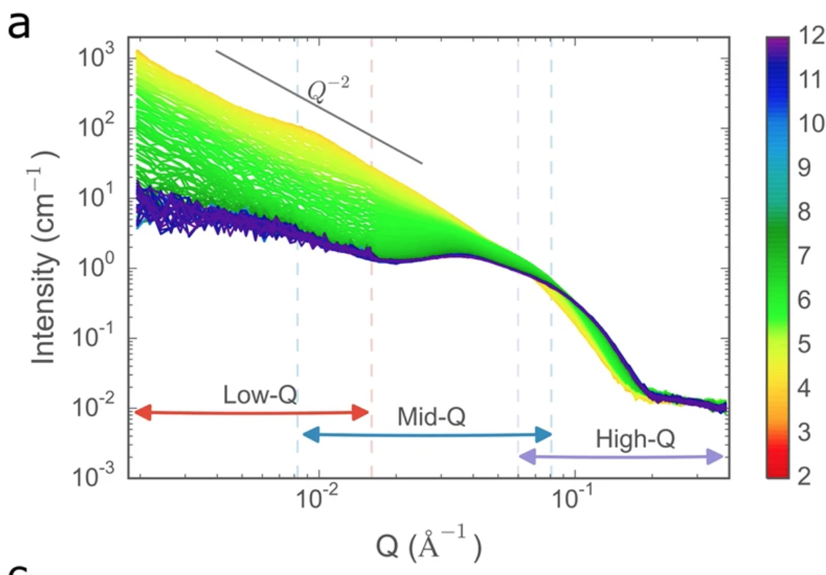
In-situ monitoring – in practice
pD
Background context

Slide 12
Quenching
Reaction (or an aliquot) is “quenched” after a certain amount of time (≥ ms).
Quenching can be carried out by mixing, eg, sudden change in pH or dilution, or by a sudden drop in temperature.
Have to be sure that quenching is fast compared to the reaction and does not cause any other changes

Slide 13
Quenching
Advantages
Disadvantages
Analytical approaches can be slow and/or destructive
Quenched samples can be stored and reanalysed using different methods
Timescale limited by speed of quenching

Slide 14
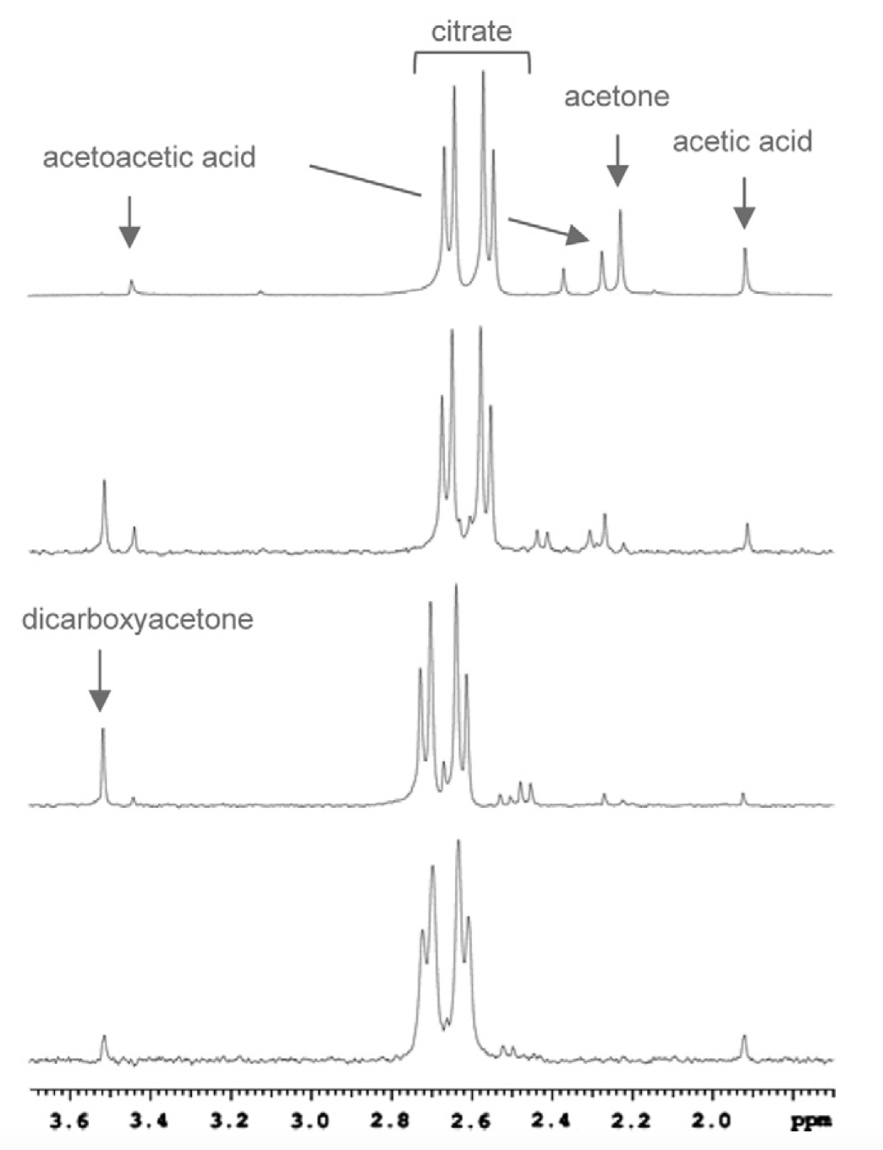
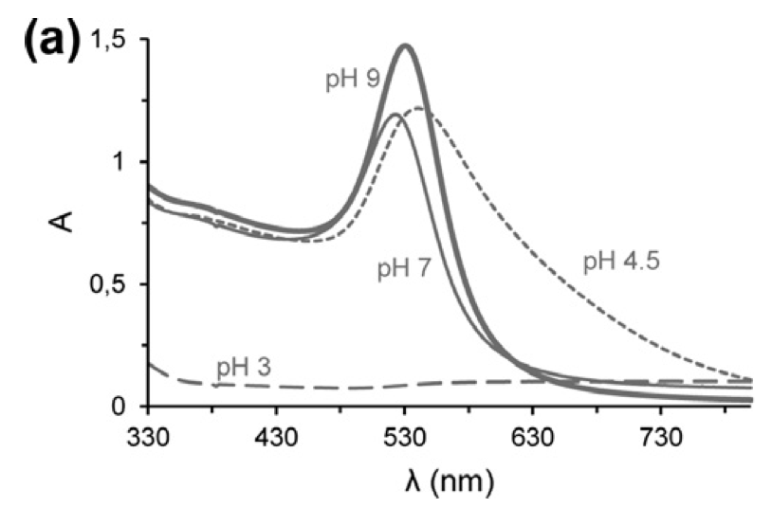
Quenching: gold-citrate aggregates in gold nanoparticle synthesis
120 min.
20 min.
4 min.
1 min.
Doyen, M., Bartik, K., & Bruylants, G. (2013). UV–Vis and NMR study of the formation of gold nanoparticles by citrate reduction: Observation of gold–citrate aggregates. Journal of colloid and interface science, 399, 1-5.
Background context
Notes:
Ice bath quench

Slide 15
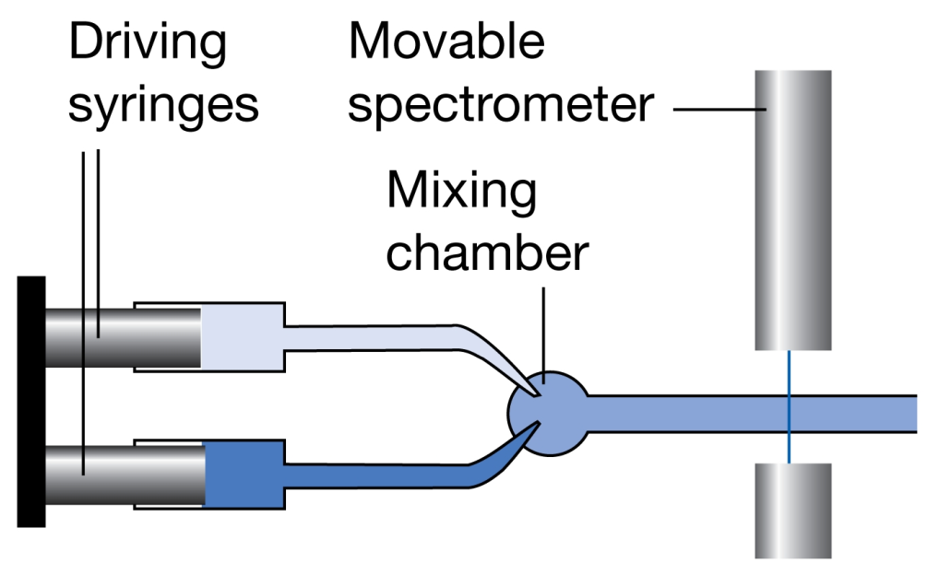
Continuous flow
Observing the composition at different positions = reaction mixtures at different times after mixing.
Timescale ≥ ms
Analytical technique must be position specific
Analytical technique can be slow compared to reaction

Slide 16
Continuous flow
Advantages
Disadvantages
Conceptually simple
Fast mixing
Large volumes of reagents required
Requires movable spectrometer

Slide 17
Continuous flow
Advantages
Disadvantages
Conceptually simple
Fast mixing
Large volumes of reagents required
Requires movable spectrometer

Slide 18
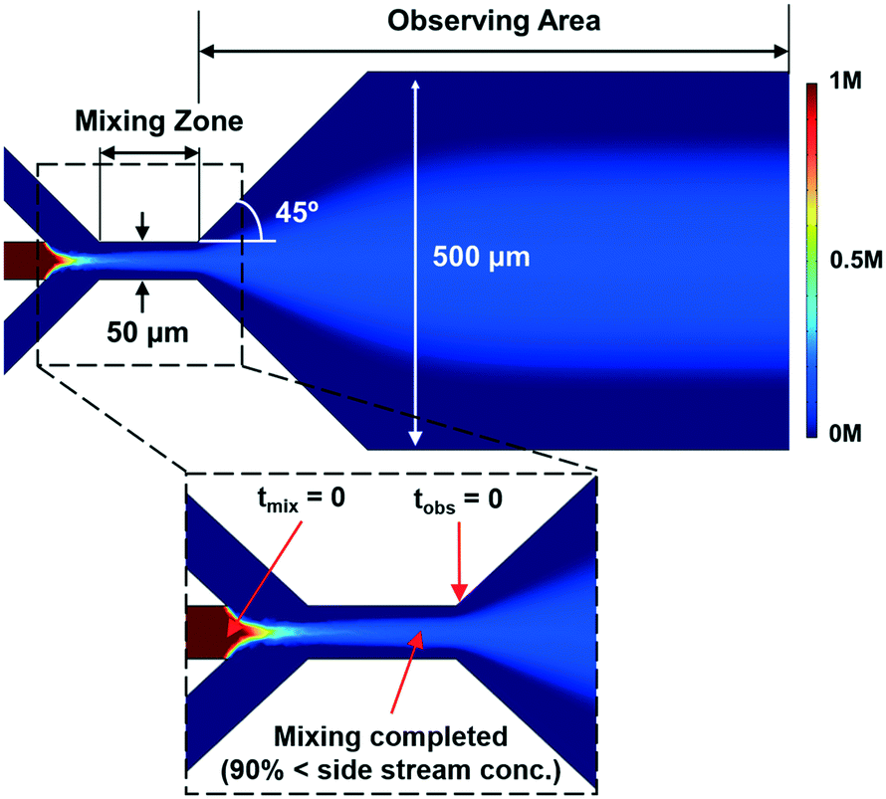
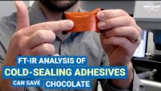
Microfluidic FT-IR Imaging
https://www.youtube.com/watch?v=_V-iSOOTBAs
Jang, H., Pawate, A. S., Bhargava, R., & Kenis, P. J. (2019). Polymeric microfluidic continuous flow mixer combined with hyperspectral FT-IR imaging for studying rapid biomolecular events. Lab on a Chip, 19(15), 2598-2609.
Background context

Slide 19
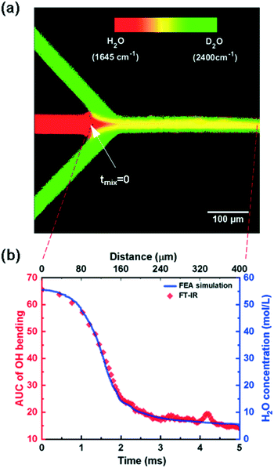
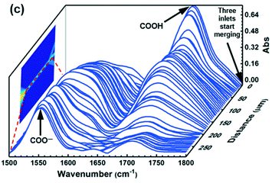
Microfluidic FT-IR Imaging
Jang, H., Pawate, A. S., Bhargava, R., & Kenis, P. J. (2019). Polymeric microfluidic continuous flow mixer combined with hyperspectral FT-IR imaging for studying rapid biomolecular events. Lab on a Chip, 19(15), 2598-2609.
Background context

Slide 20
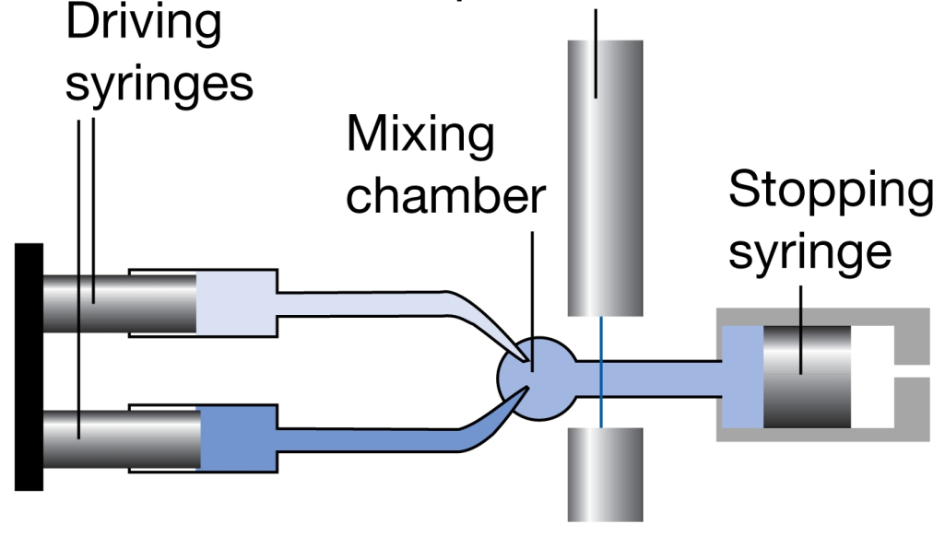
Stopped flow
Fast mixing can be achieved in ~1ms with “stopped flow” technique (so appropriate if reaction is slower than this)
Monitoring
This can be used with liquids or gases.
(Picture from Atkins’ Physical Chemistry 7th ed)

Slide 21
Stopped flow
Advantages
Disadvantages
Uses small sample volumes – particularly beneficial if your reagent is expensive/hard to produce
Requires specialist kit

Slide 22
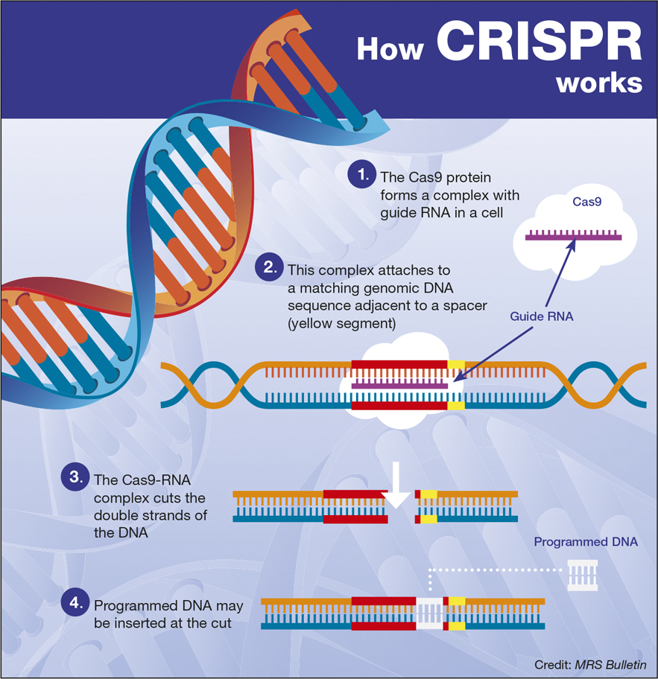
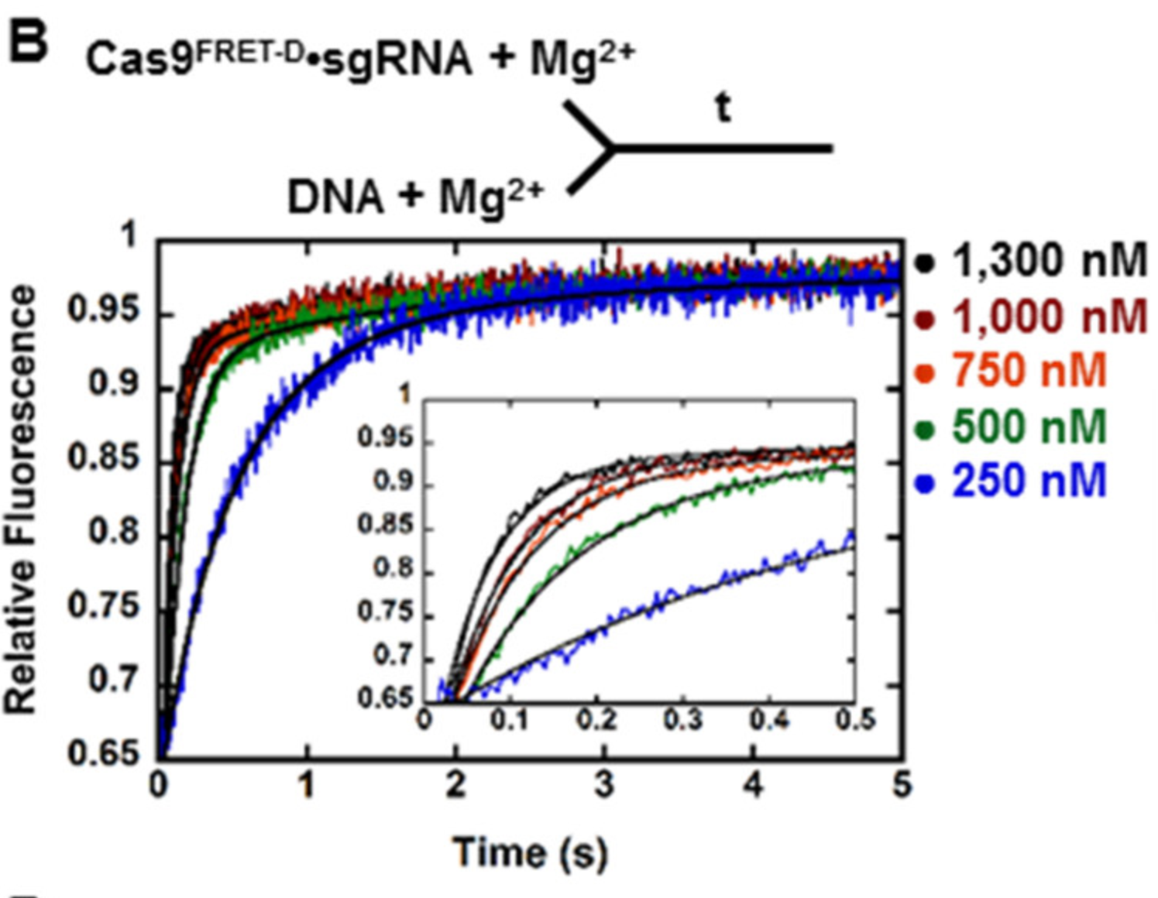
CRISPR DNA Editing
Raper, A. T., Stephenson, A. A., & Suo, Z. (2018). Functional insights revealed by the kinetic mechanism of CRISPR/Cas9. Journal of the American Chemical Society, 140(8), 2971-2984.
Background context

Slide 23

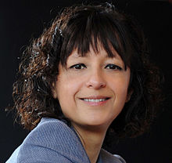
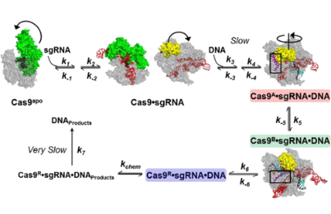
CRISPR DNA Editing
Raper, A. T., Stephenson, A. A., & Suo, Z. (2018). Functional insights revealed by the kinetic mechanism of CRISPR/Cas9. Journal of the American Chemical Society, 140(8), 2971-2984.
Jennifer Doudna and Emmanuelle Charpentier – Nobel Prize in Chemistry 2020
Background context

Slide 24
ULTRAfast reactions
CH2PH2 Chemical Kinetics

Slide 25
Reaction time << ms?

Slide 26
Starting reactions with light
Before first lasers invented (1960s), light flashes could be generated in microseconds (10⁻⁶ s)
“Flash photolysis” – developed by Norrish and Porter in the 1950s – use a flash of light to break bonds, to produce reactive species (“pump” pulse)
Monitor reaction spectroscopically with another beam (“probe”) in real time.
Nowadays, lasers can easily generate nanosecond (10⁻⁹ s) to femtosecond (10⁻¹⁵ s) pulses

Slide 27
Photolysis of Acetone to produce methyl radicals
O
O
fast
2 ·CH₃
C₂H₆
CH₃
C
CH₃
pump
·C
·CH₃+CO
·CH₃
CH₃
probe
“Pump” pulse can
  Break bonds to give radicals
  Generate electronically excited states
  Remove a (designed light-sensitive) protecting group from, e.g., an enzyme
  Produce a precursor which (quickly) produces reagent
  Heat; by (a) mixing a dye that absorbs at a certain wavelength, or(b) using an IR pulse tuned to, eg, OH stretch in water.

Slide 28


Designing a pump-probe experiment
Light 2
Sample cell
Probe
Light detector
Eg
Photodiode
Pump
Timing
electronics
Light 1
Pump beam is intense (to cause chemical change)
Probe beam is not intense (this should not cause chemical change!)
…so shine in different directions (so pump pulse doesn’t ruin your light detector)
Pump beam travels across width of cell (so ensure uniform illumination). Probe beam travels along length of cell (increase signal)

Slide 29
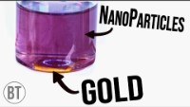
Laser ablation of nanoparticles
https://youtu.be/m_ScOUNAdlM?t=101
Background context

Slide 30
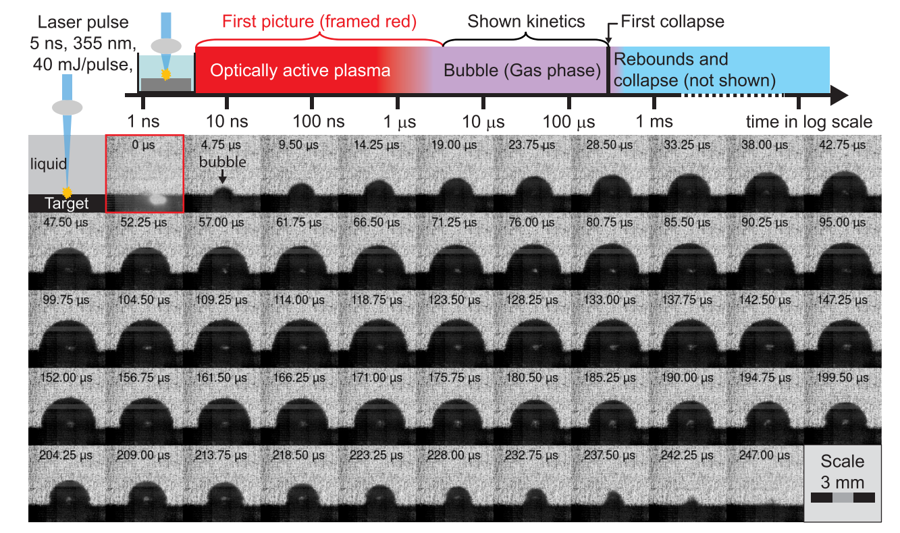
Laser ablation of nanoparticles
Background context
Lam, J., Lombard, J., Dujardin, C., Ledoux, G., Merabia, S., & Amans, D. (2016). Dynamical study of bubble expansion following laser ablation in liquids. Applied Physics Letters, 108(7), 074104.

Slide 31
Changing probe wavelength
Probe can be white (or, in general, “polychromatic”) - contains a mixture of different wavelengths.
Intensity
Wavelength
…or can be monochromatic: all the light has the same wavelength, usually: absorption by a species of interest.
Spectrum of intermediate
Intensity
Wavelength

Slide 32
Using white light as the probe
White light can be split up using a prism or diffraction grating.
The light can then be detected with an array of detectors, to give a spectrum.
Probe beam of white light
Sample
Alternatively, you can use a “monochromator” with a single detector, to pick a single wavelength at a time.

Slide 33
Pump and probe lasers
Pump and probe are usually different lasers / light sources.
  Pump has to be intense but exact wavelength less important; probe has to be “tunable” so you can vary the wavelength to probe the specific species that you want to look at
Can have pulse and probe from same laser (see later slide)
Each pump pulse usually only makes a small fraction of (pre-) reactant react, so probe only detects a very small signal. The reaction can therefore be repeated many times, adding all of the probe data, to increase the signal.

Slide 34
Probe Timing
Option 1: Timing of probe light is
  On continuously (detector system records absorption throughout reaction; triggered by pump pulse)
  Real-time data acquired through a computer. (Note: maximum computer speed – we can only study phenomena as fast as we can save the data)

Slide 35
Continuous Laser Absorption
Probe wavelength set to absorption by reactant (generated by pump)
Absorption of probe by unstable reactant
Pump
pulse
Reactive species disappears through reaction
Time
Probe wavelength set to absorption by intermediate
Absorption of probe by intermediate
Pump
pulse
Intermediate appears then disappears
Time

Slide 36
Probe Timing
Option 2: Timing of probe light may be
  Pulsed, with a fixed delay after the pump pulse. (You repeat the experiment varying the delay)
  Data acquired continuously

Slide 37
Pulsed laser absorption
Probe wavelength set to absorption by reactant
Variable delay
Absorption of probe by unstable reactant
Pump
pulse
Probe
pulse
Time
(2) Probe wavelength set to absorption by intermediate
Absorption of probe by intermediate
Pump
pulse
Variable delay
Probe
pulse
Time

Slide 38
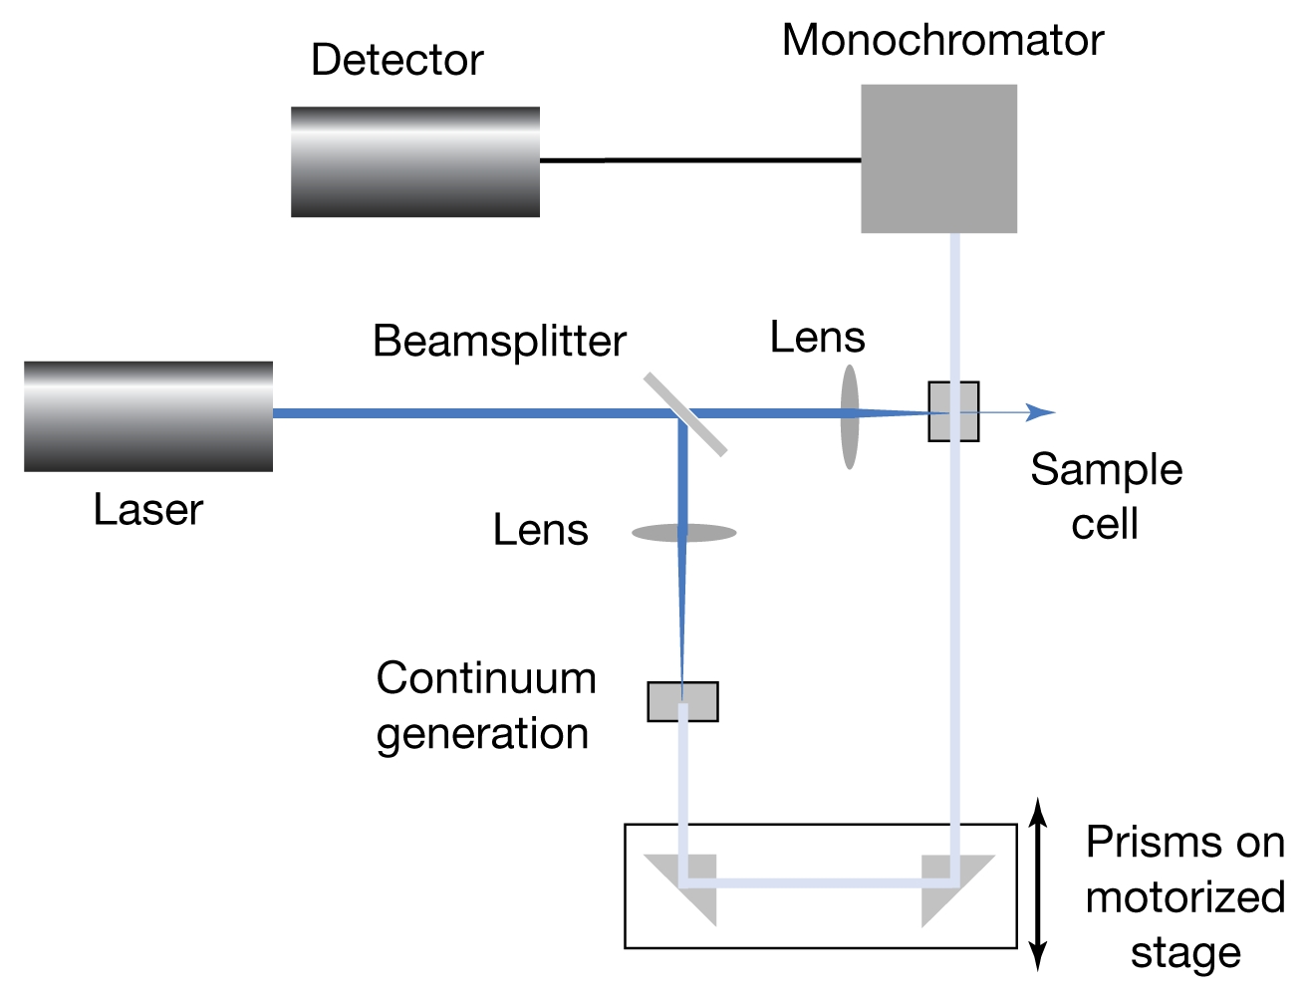
Using the same light source
Eg. If x = 15cm = 0.15m
Probe pulse travels 2x
= 0.3m further than pump pulse.
It therefore arrives at the sample
0.3 / (3 x 10⁸ ms⁻¹) = 1ns later than the pump pulse. (Time = distance / speed)
Mono-chromatic pump beam
x
White light generation
White probe beam

Slide 39
Learning outcomes
Today we have:
Reviewed various methods for measuring kinetics in real experiments
Described methods for in situ monitoring
Described methods for measuring very fast kinetics processes.

Slide 40
And in summary
During this lecture course we have covered:
Multi-step kinetics
Steady-state approximation
Chain reactions
Branching reactions and explosions
Practical kinetics

